Slide 1
Federated Learning-based Machinery Failure Time Predictor for Decentralized Imaging Data
Chengyu Zhou
Joint work with Yuqi Su, Dr. Xiaolei Fang
Edward P. Fitts Department of Industrial and Systems Engineering
North Carolina State University

Slide 2
Outline
Motivation and Challenge
Proposed Methodology
Simulation and Case Studies
Summary

Slide 3
Motivation
Most existing prognostic models assume we have enough dataset for model training.
However, the number of data samples associated with failures from a single organization (e.g., a company, a factory, a hospital and an original equipment manufacturer) is limited.
Consequently, a single organization is usually either unable to train prognostic models or its trained models are neither effective nor reliable.

Slide 4
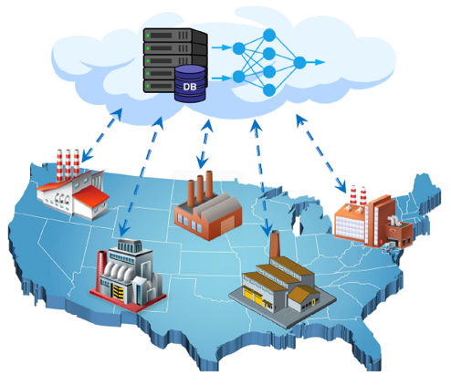
One Possible Solution
Cloud computing-based prognostics
It allows each organization to upload its data to a server on the cloud
The server then aggregates the data from all the organizations and uses them for prognostics model training
The training model is then sent back to each organization for real-time condition monitoring and failure time prediction
Limitations
Cannot Protect Privacy
High Cost
Fig: An illustration of cloud computing-based prognostics

Slide 5
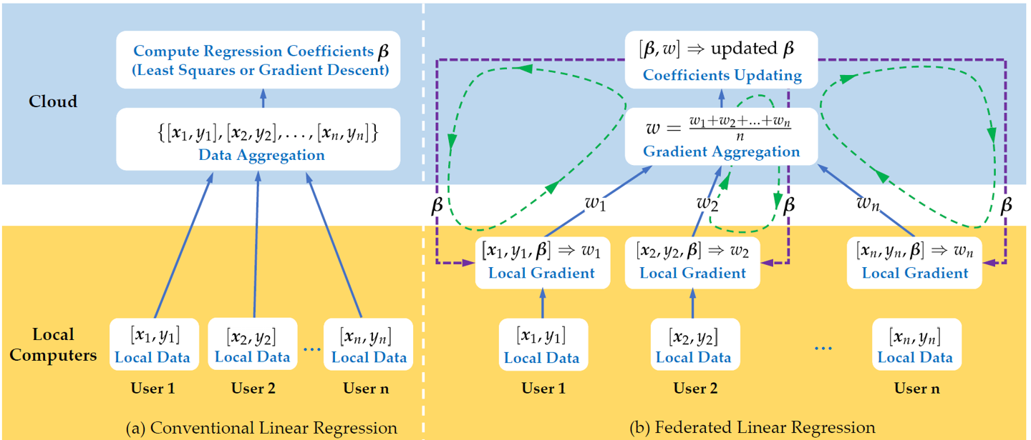
Federated Learning (FL)
FL allows multiple organizations to use their isolated data to jointly train machine learning models while keeping each participant’s data local and confidential.
Objective of Topic III: Build a tensor-based federated prognostic model for applications with imaging data

Slide 6
Framework
Step I. Dimension Reduction
Multilinear Principal Component Analysis (MPCA)
(Lu et al., 2008)
Step I. Dimension Reduction
Federated Multilinear Principal Component Analysis
(Contribution in this topic )
Step II. LLS Tensor Regression
Step II. Federated LLS Regression
(Su and Fang, 2023)
Classic Image-based Prognostic Model
(Fang, Paynabar, and Gebraeel, 2019)
(Not Federated)
Federated Image-based Prognostic Model
(Proposed by this project)

Slide 7
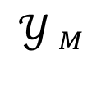
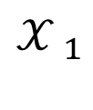
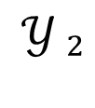
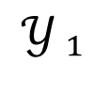
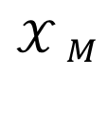
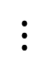
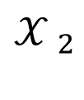
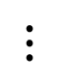
MPCA (Lu et al., 2008): Objectives
High-dimensional Tensor
Low-dimensional Tensor
$${𝒳 }_{1}$$
$${𝒴 }_{1}$$
Tensor Subspace
$${𝒳 }_{2}$$
$${𝒴 }_{2}$$
$$⋮$$
$$⋮$$
$${𝒳 }_{M}$$
$${𝒴 }_{M}$$
Project high-dimensional tensors to a low-dimensional tensor subspace and obtain low-dimensional tensors.
The projected low-dimensional tensors can capture most of the information of original high-dimensional tensors.
Q2. How to identify the tensor subspace ?
Q1. How to measure the information ?

Slide 8
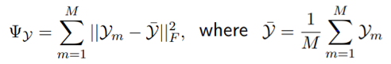
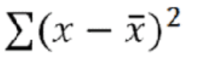
MPCA (Lu et al., 2008): Objectives
Question 1: How to measure information captured by low-dimensional tensors?
Sample Size
Tensor Scatter
Projected Low-dimensional Tensor
Variance

Slide 9
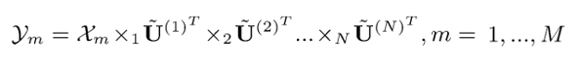
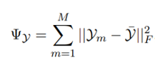
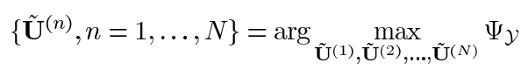
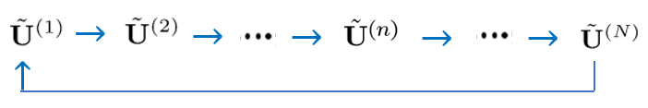
MPCA (Lu et al., 2008): Objectives
Question 2: How to identify tensor subspace?
High-dimensional Tensor
Low-dimensional Tensor
Tensor subspace
?
Tensor Scatter

Slide 10
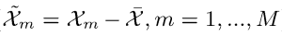
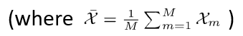
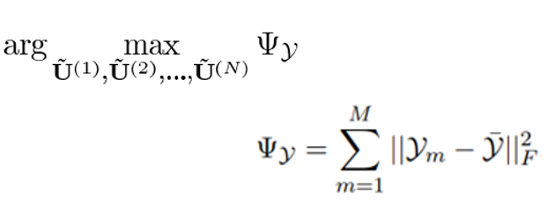
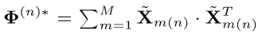
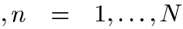
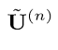
MPCA (Lu et al., 2008): Optimization Algorithm
Step 1: Preprocessing (Centralization)
Step 2: Initialization
High-dimensional Tensor
Unfold to matrix form
in the nth mode, n = 1, …, N
Eigen-Decomposition
Covariance Matrix
Initialized Projection Matrix
in the nth Mode

Slide 11
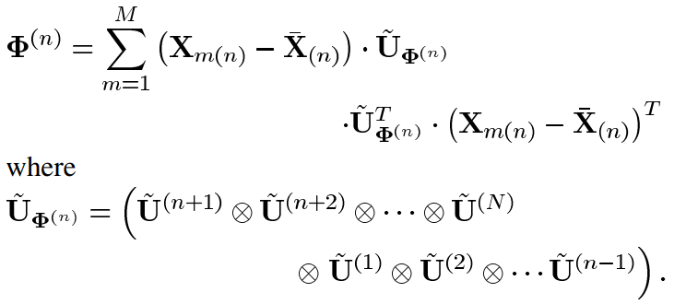
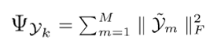
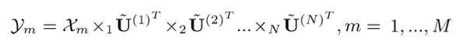
MPCA (Lu et al., 2008): Optimization Algorithm
Step 3: Iterative Updating
Step 4: Projection
Theorem 1 (Lu et al., 2008)
Eigen-Decomposition
Converged ?

Slide 12
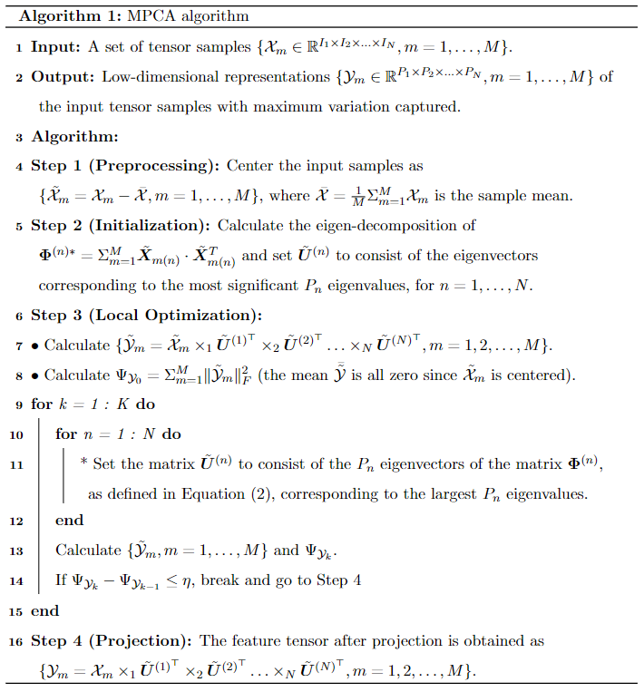
MPCA(Lu et al., 2008): Optimization Algorithm
Challenge 1
Challenge 2
Challenge 3

Slide 13
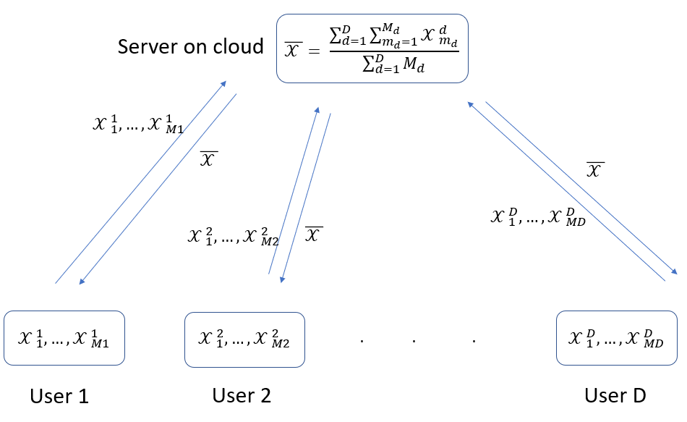
Privacy Protection Challenge 1 in MPCA
Step 1: Data centralization
Raw Data
Global
Mean
Fig: The flowchart of data centralization in Step 1 (no privacy protection)

Slide 14
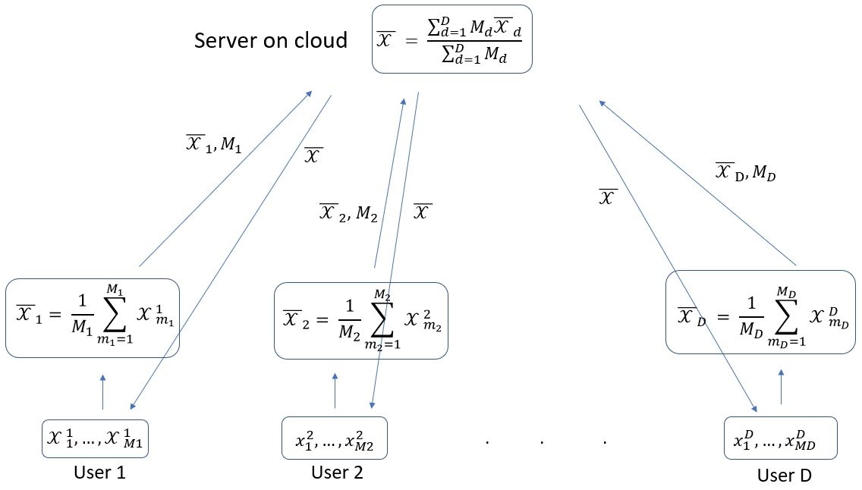
Naïve Solution for Privacy Protection Challenge 1
One Naive Solution:
Local Mean
Local Sample Size
Global
Mean
Local Mean
Fig: The flowchart of data centralization in Step 1 (local mean is shared)

Slide 15
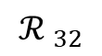
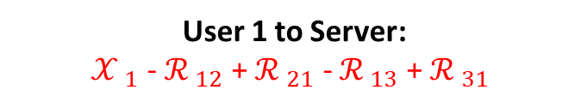
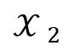
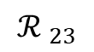
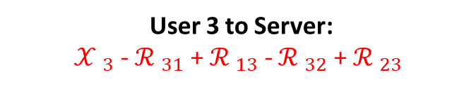
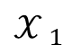
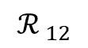
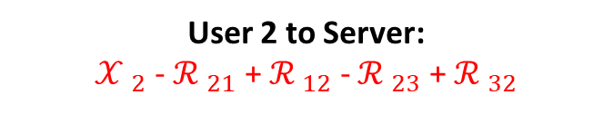
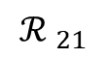
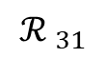
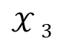
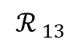
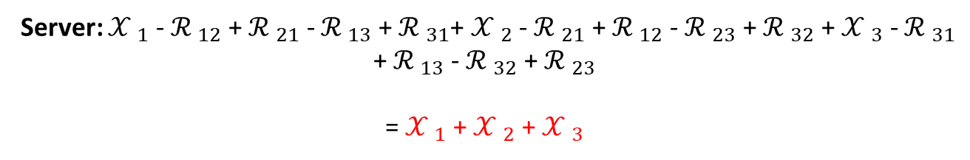
Solution for Privacy Protection Challenge 1
Practical Secure Aggregation (Bonawitz et al. 2016)
User 1
User 1 to Server:
${𝒳 }_{1}$ - ${ℛ }_{12}$ + ${ℛ }_{21}$ - ${ℛ }_{13}$ + ${ℛ }_{31}$
$${𝒳 }_{1}$$
$${ℛ }_{21}$$
$${ℛ }_{31}$$
User 2 to Server:
${𝒳 }_{2}$ - ${ℛ }_{21}$ + ${ℛ }_{12}$ - ${ℛ }_{23}$ + ${ℛ }_{32}$
$${ℛ }_{12}$$
$${ℛ }_{13}$$
User 3 to Server:
${𝒳 }_{3}$ - ${ℛ }_{31}$ + ${ℛ }_{13}$ - ${ℛ }_{32}$ + ${ℛ }_{23}$
$${ℛ }_{23}$$
$${𝒳 }_{2}$$
User 2
$${𝒳 }_{3}$$
User 3
$${ℛ }_{32}$$
Server: ${𝒳 }_{1}$ - ${ℛ }_{12}$ + ${ℛ }_{21}$ - ${ℛ }_{13}$ + ${ℛ }_{31}$+ ${𝒳 }_{2}$ - ${ℛ }_{21}$ + ${ℛ }_{12}$ - ${ℛ }_{23}$ + ${ℛ }_{32}$ + ${𝒳 }_{3}$ - ${ℛ }_{31}$ + ${ℛ }_{13}$ - ${ℛ }_{32}$ + ${ℛ }_{23}$
= ${𝒳 }_{1}$ + ${𝒳 }_{2}$ + ${𝒳 }_{3}$

Slide 16
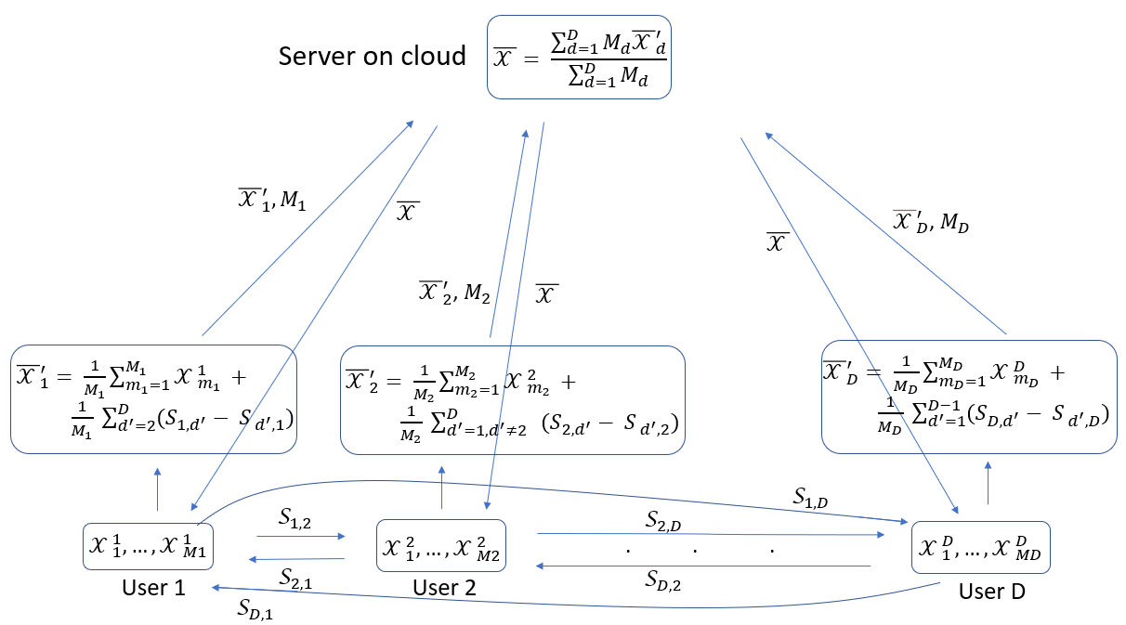
Solution for Privacy Protection Challenge 1
Secure Centralization Flowchart:
Protected Local Mean
Global
Mean
Random Number
Fig: The flowchart of data centralization in Step 1 (with privacy protection)
Data can be Protected.

Slide 17
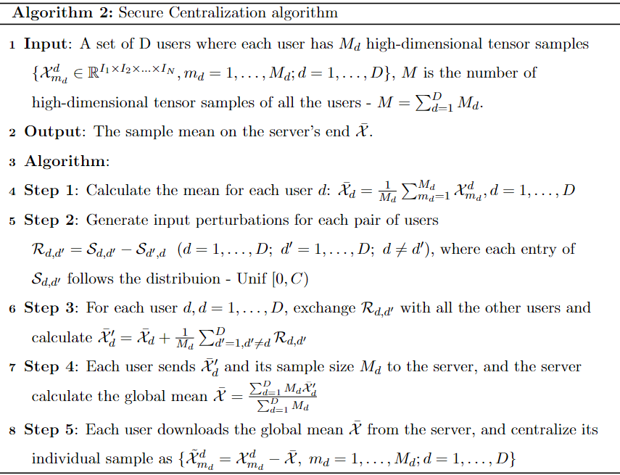
Solution for Privacy Protection Challenge 1

Slide 18
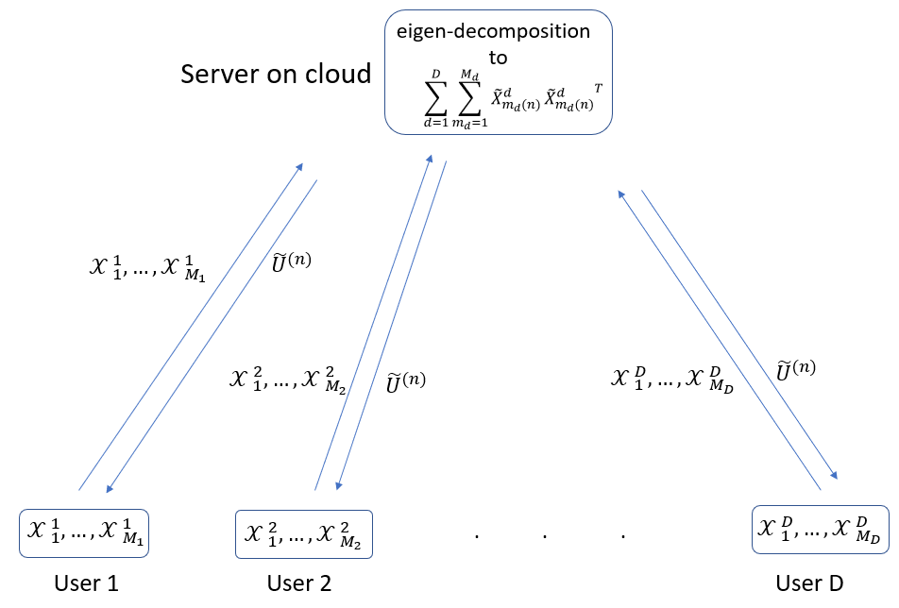
Privacy Protection Challenge 2 in MPCA
Step 2: Eigen-Decomposition
Raw Data
Projection
Matrix
Fig: The flowchart of eigen decomposition in Step 2 (no privacy protection)

Slide 19
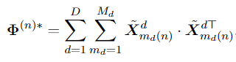
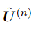

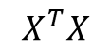
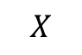
Inspiration for Privacy Protection Challenge 2
The Number of Users
Sample Size of Each User
Projection Matrix
Eigen-Decomposition
Step 2:
Challenge: Aggregate data of all the users, cannot protect privacy.
A fact that inspires our solution
Eigen-Decomposition
$$X^{T}X$$
Eigenvectors
Incremental SVD
SVD
$$X$$
Unitary Matrix U

Slide 20
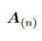
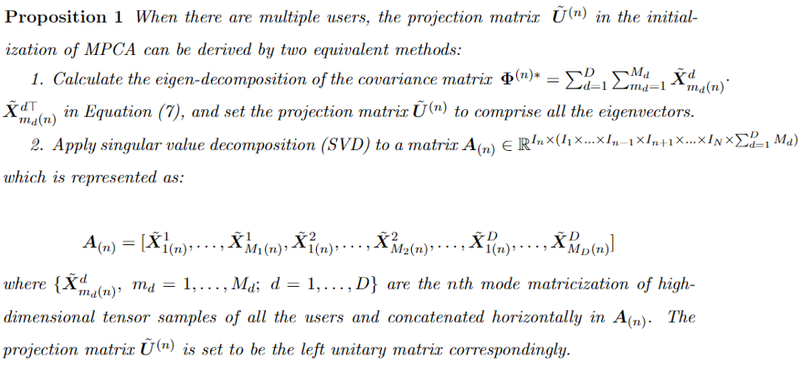

Solution for Privacy Protection Challenge 2
Cannot protect privacy
Eigen
Decomposition
SVD

Slide 21





Solution for Privacy Protection Challenge 2
Algorithm 3
SVD
$U$ $∑$ $V$
Update
Update
Not Shared
The existing incremental SVD assumes the matrix is low rank.
But our matrix is full rank due to noise.
Thus, we proposed a Federated Incremental SVD for full rank matrix.

Slide 22

Solution for Privacy Protection Challenge 2
Updating Steps

Slide 23



Solution for Privacy Protection Challenge 2
Residual
Prove the feasibility of
obtaining Projection Matrix
${\tilde{U}}^{(n)}$ by Algorithm 3
Updating Steps

Slide 24

Solution for Privacy Protection Challenge 2
Fig: The flowchart of eigen decomposition in Step 2 (with privacy protection)
V is not shared, raw data cannot be recovered, then privacy can be protected

Slide 25


Privacy Protection Challenge 3 in MPCA
Step 3: Eigen-Decomposition
Raw Data
Projection
Matrix
Fig: The flowchart of eigen decomposition in Step 3 (no privacy protection)

Slide 26




Solution for Privacy Protection Challenge 3
Cannot protect privacy
Eigen
Decomposition
SVD

Slide 27


Solution for Privacy Protection Challenge 3
Algorithm 4
Not Shared

Slide 28

Solution for Privacy Protection Challenge 3
Updating Steps

Slide 29



Solution for Privacy Protection Challenge 3
Residual
Prove the feasibility of
obtaining Projection Matrix ${\tilde{U}}^{(n)}$
by Algorithm 4
Updating Steps

Slide 30

Solution for Privacy Protection Challenge 3
Fig: The flowchart of eigen decomposition in Step 2 (with privacy protection)
V is not shared, raw data cannot be recovered, then privacy can be protected

Slide 31

FMPCA Algorithm
Solution for privacy protection challenge 1
Solution for privacy protection challenge 2

Slide 32

FMPCA Algorithm
Solution for privacy protection challenge 3

Slide 33

Federated (Log) Location Scale Regression

Slide 34

Federated (Log) Location Scale Regression

Slide 35





Simulation Study
For system , its image stream, , is generated from the following heat transfer process:
Thermal diffusivity coefficient:
Noise: i.i.d. are added to each pixel

Slide 36


Simulation Study
Sample size: 500 systems; image size $21×21$; 400 systems for training and the remaining 100 for test; the number of images for different systems are different (truncated by TTF)
Time-to-failure (TTFs)
Transform each image stream to a time series by taking the average pixel intensity of each image
The TTF is the time point that the time series signal crosses 23
Benchmark:
Combined Data (400 Samples, Without Privacy Protection)
Decentralized Data of Individual Users

Slide 37


Results
(400)
(400)
(250)
(100)
(50)
The performance of our proposed method is the same as the 1st benchmark “User Combination”.
“FMPCA” outperforms the other 3 benchmarks - “User1”, “User 2” and “ User 3”.
“User1” > “User 2” > “ User 3”.

Slide 38



Case Study
Experiments: degradation tests for rolling element bearings
Each image: $40×20$ pixels
Time-to-failure: $[15, 55]$ minutes

Slide 39

Results
(400)
(400)
(250)
(100)
(50)
The performance of our proposed method is the same as the 1st benchmark “User Combination”.
“FMPCA” outperforms the other 3 benchmarks - “User1”, “User 2” and “ User 3”.
“User1” > “User 2” > “ User 3”.

Slide 40
Summary and Conclusions
A Federated Multilinear Principal Component Analysis (FMPCA) Model was proposed which aims to preserve user privacy and data security for multilinear principal component analysis (MPCA).
The objective is achieved by proposing three solutions towards data leakage locations in MPCA.
Simulation and case studies were performed.
The results show that our proposed method can derive the same projection matrices as MPCA and indicate there is no performance loss while preventing privacy violation.

